Slide 1
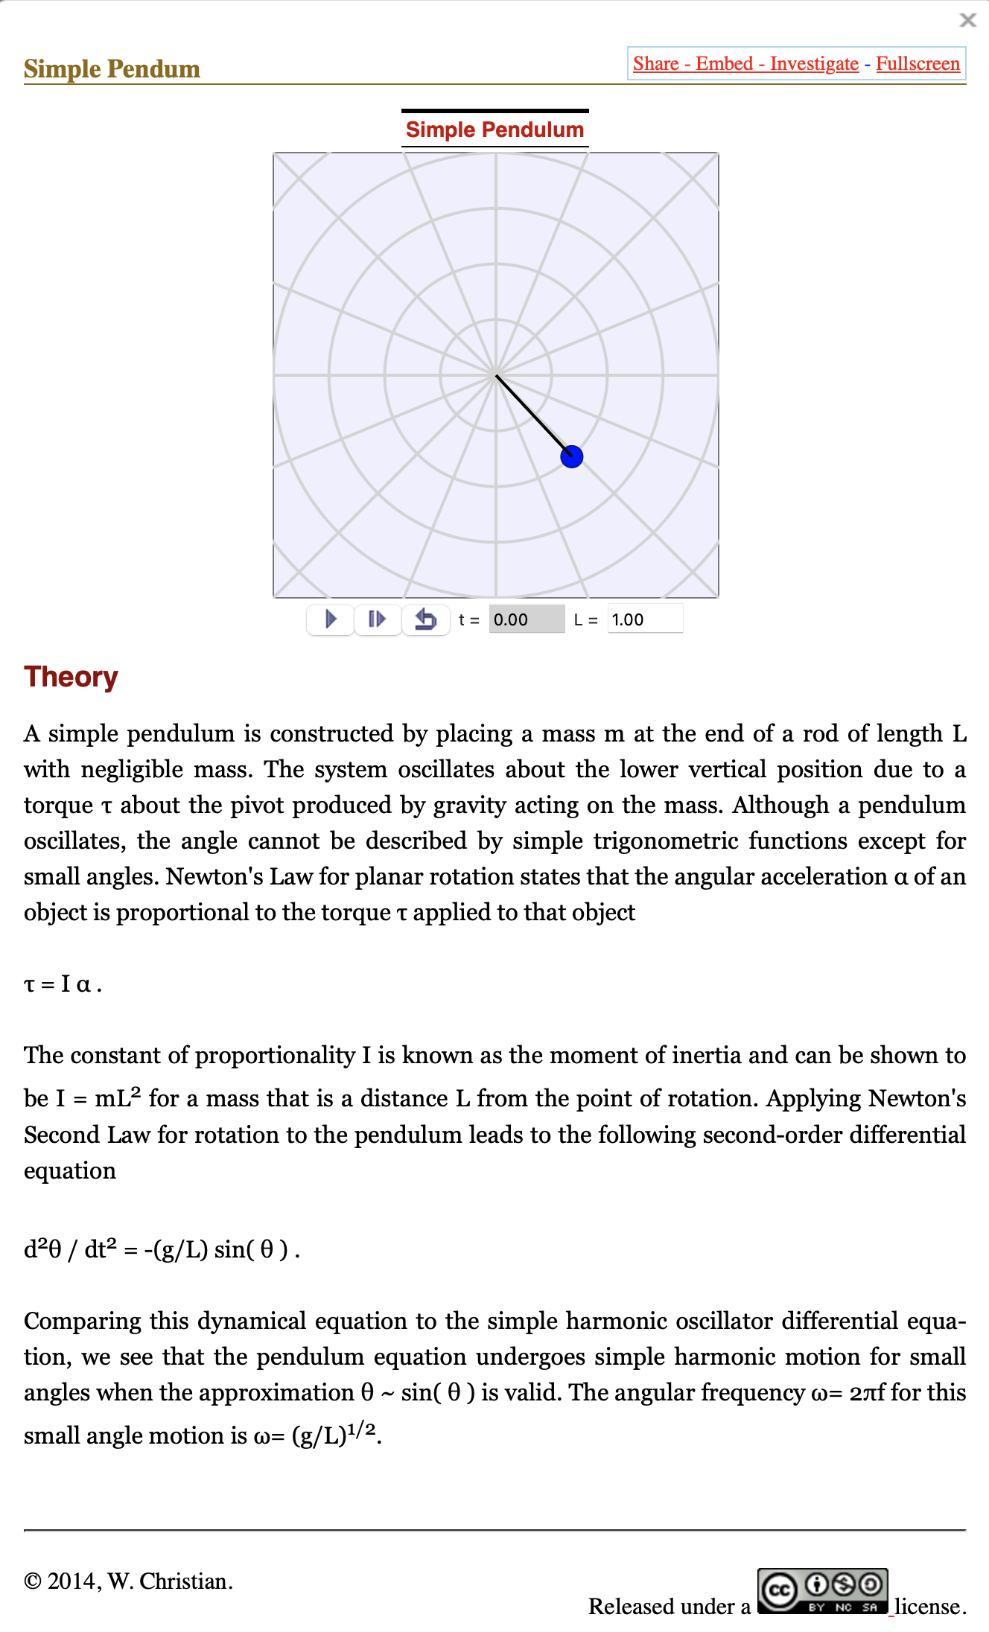
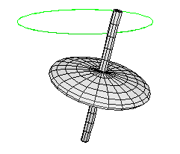
Guided Tour to the WebEJS Authoring Toolkit
Francisco Esquembre
Creation of Interactive Resources Using the WebEJS Authoring Toolkit
Powered by WebEJS

Slide 2
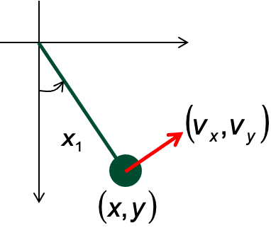
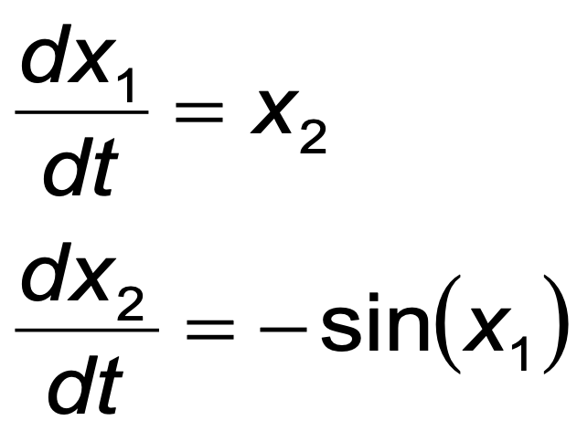
Before we start the Tour...
A simulation (interactive) consists of:
Model
View
Creation of Interactive Resources Using the WebEJS Authoring Toolkit
Powered by WebEJS

Slide 3
Before we start the Tour...
A simulation (interactive) consists of:
The model is a quantification of the simulated process in terms of parameters, variables, and formulas…
…in a form that can be programmed and run in a (discrete) computer.
A model describes the logic in terms of numbers.
Model
View
Creation of Interactive Resources Using the WebEJS Authoring Toolkit
Powered by WebEJS

Slide 4
Before we start the Tour...
A simulation (interactive) consists of:
The view is a visualisation of the process that helps understand the behaviour of the model and also manipulate it…
…in a graphical form using plots, virtual worlds, and controls.
A view displays the process and allows interaction to perform experiments.
Model
View
Creation of Interactive Resources Using the WebEJS Authoring Toolkit
Powered by WebEJS

Slide 5
Before we start the Tour...
Finally, model and view, should come with a Description, providing information, instructions of use...
Description
View
Model
Creation of Interactive Resources Using the WebEJS Authoring Toolkit
Powered by WebEJS

Slide 6
Before we start the Tour...
Our work with WebEJS consists of providing these in the Graphical User Interface (GUI) of the program ...
Description
View
Model
Creation of Interactive Resources Using the WebEJS Authoring Toolkit
Powered by WebEJS

Slide 7
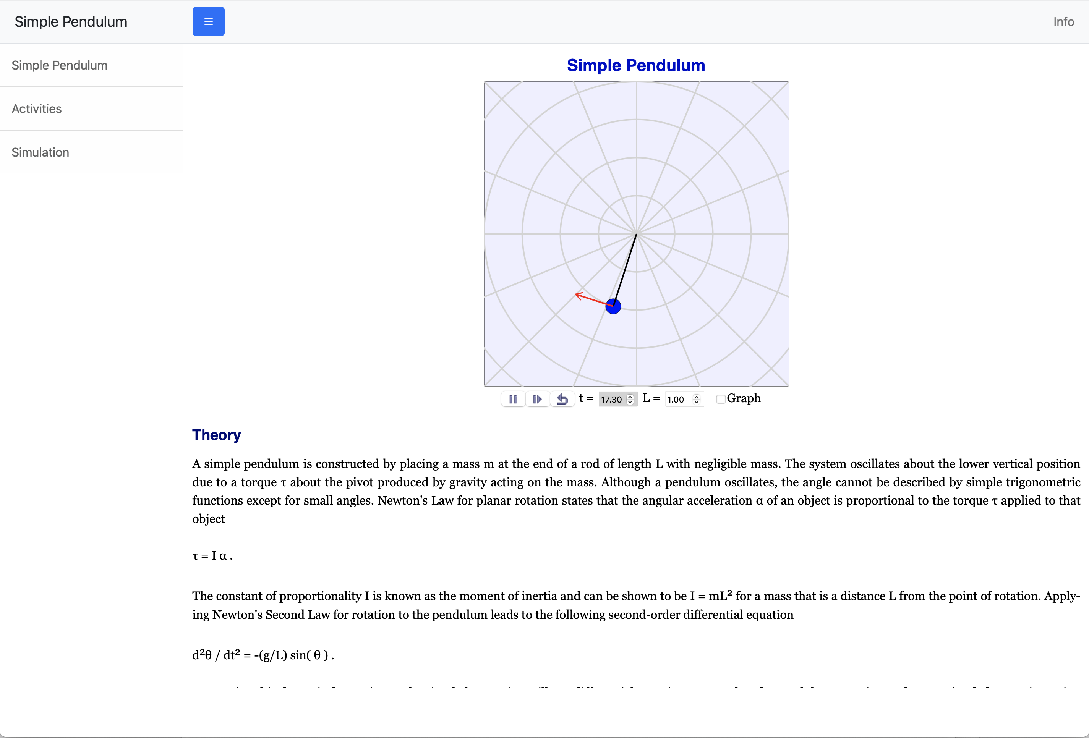
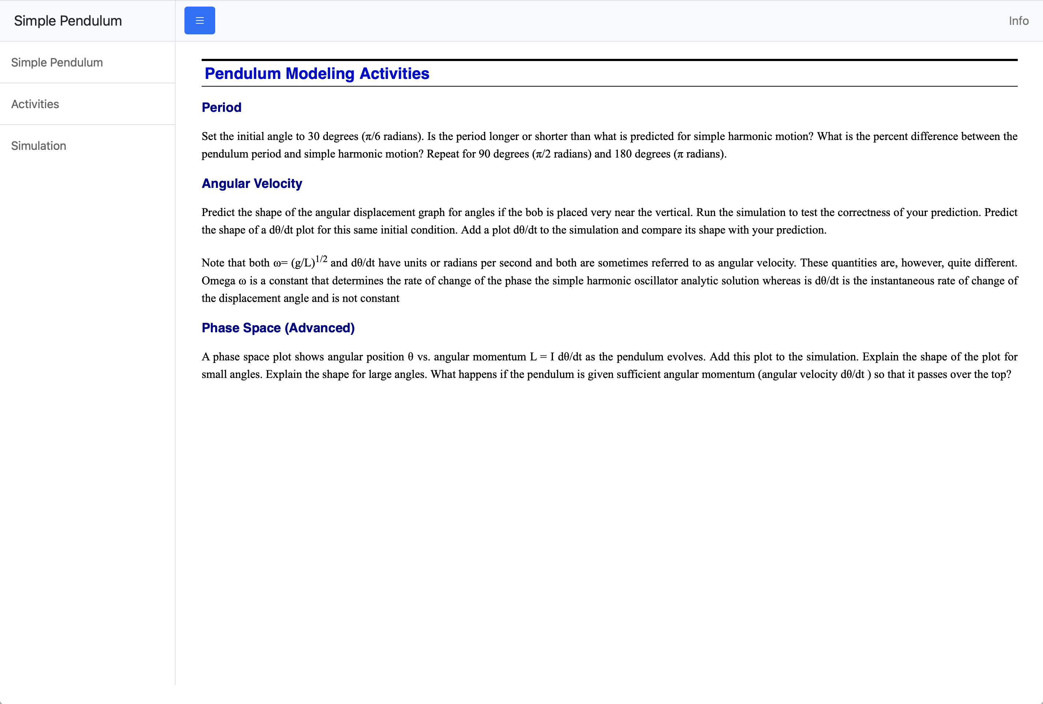
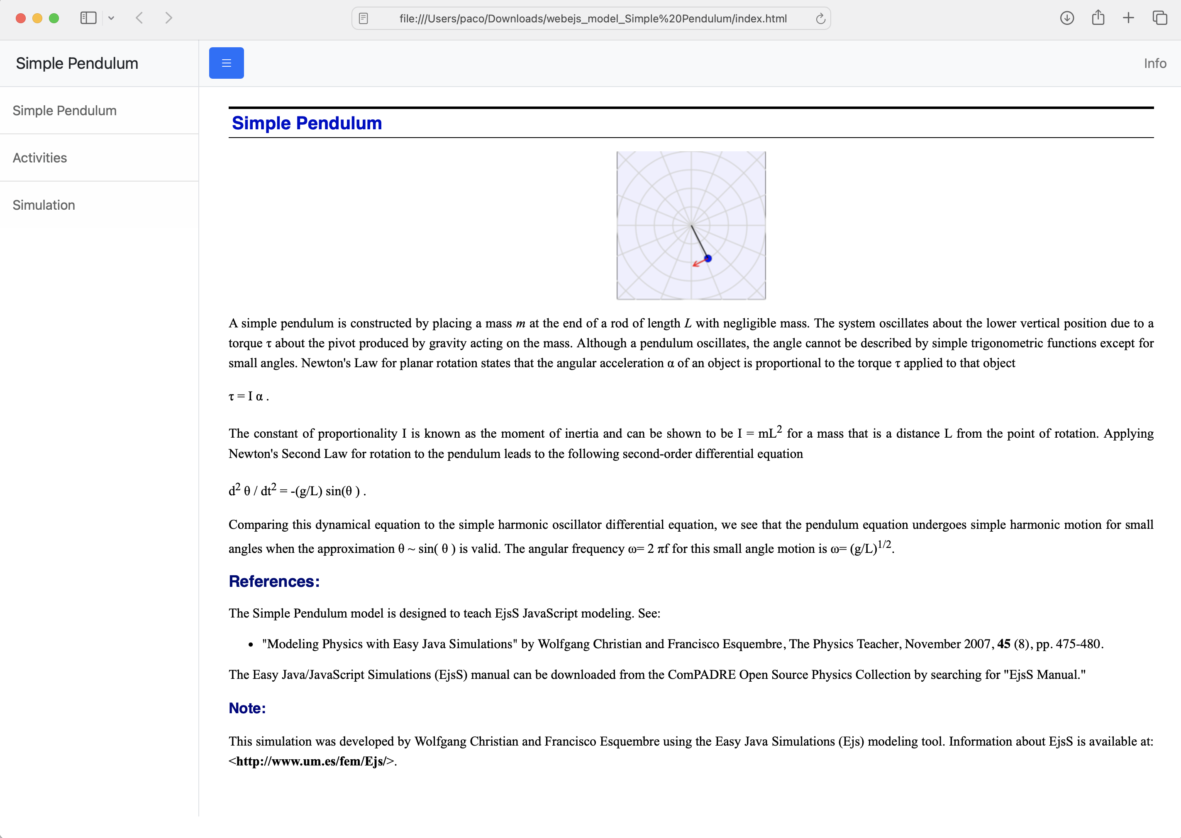
Before we start the Tour...
... so that WebEJS can generate this:
Creation of Interactive Resources Using the WebEJS Authoring Toolkit
Powered by WebEJS

Slide 8
Now, the Tour...
We explain the interface of WebEJS
We load a simulation from our hard disk
We explore the simulation
We edit it very slightly
We save it to our hard disk
Explore and download from repositories
opensourcephysics.org
iwant2study.org
t.um.es/runwebejs
or
webejs.iwant2study.org
Creation of Interactive Resources Using the WebEJS Authoring Toolkit
Powered by WebEJS

